Slide 1

Natural Language Processing
Recitation Class

Slide 2

What is NLP?
Notes:
NLP is a subfield of artificial intelligence (AI) that deals with the interaction between computers and human language.
* Aid human-human communication (e.g., machine translation) • Aid human-machine communication (e.g., question answering, dialog) • Analyze/understand language (syntactic analysis, text classification, entity/relation recognition/linking) • We now use NLP several times a day, sometimes without knowing it!

Slide 3
Applications:
Sentiment Analysis: Analyzing social media data to determine public sentiment about a product or topic.
Language Translation: Services like Google Translate translate text from one language to another.
Chatbots: Virtual assistants like Siri or chatbots on websites that understand and respond to natural language queries.
Speech Recognition: Systems like Siri and Alexa that convert spoken language into text or commands.
Text Summarization: Automatically generating concise summaries of long documents or articles.

Slide 4

Challenges:
Ambiguity: Language is often context-dependent and can have multiple meanings.
Sarcasm and Irony: Understanding subtle nuances like sarcasm and irony can be challenging for NLP models.
Language Variability: NLP must account for variations in language, including dialects, slang, and regional differences.
Data Quality: NLP models require high-quality training data to perform well.

Slide 5
Ambiguity
1. Time-related Ambiguity:
Example: "I will meet you at the bank at 3 PM."
- In this sentence, "bank" could refer to a financial institution, or it could refer to the side of a river. The interpretation depends on the context.
2. Lexical Ambiguity:
Example: "I saw a bat."
- "Bat" could refer to the flying mammal or a sports equipment used in baseball. The meaning depends on the context.

Slide 6
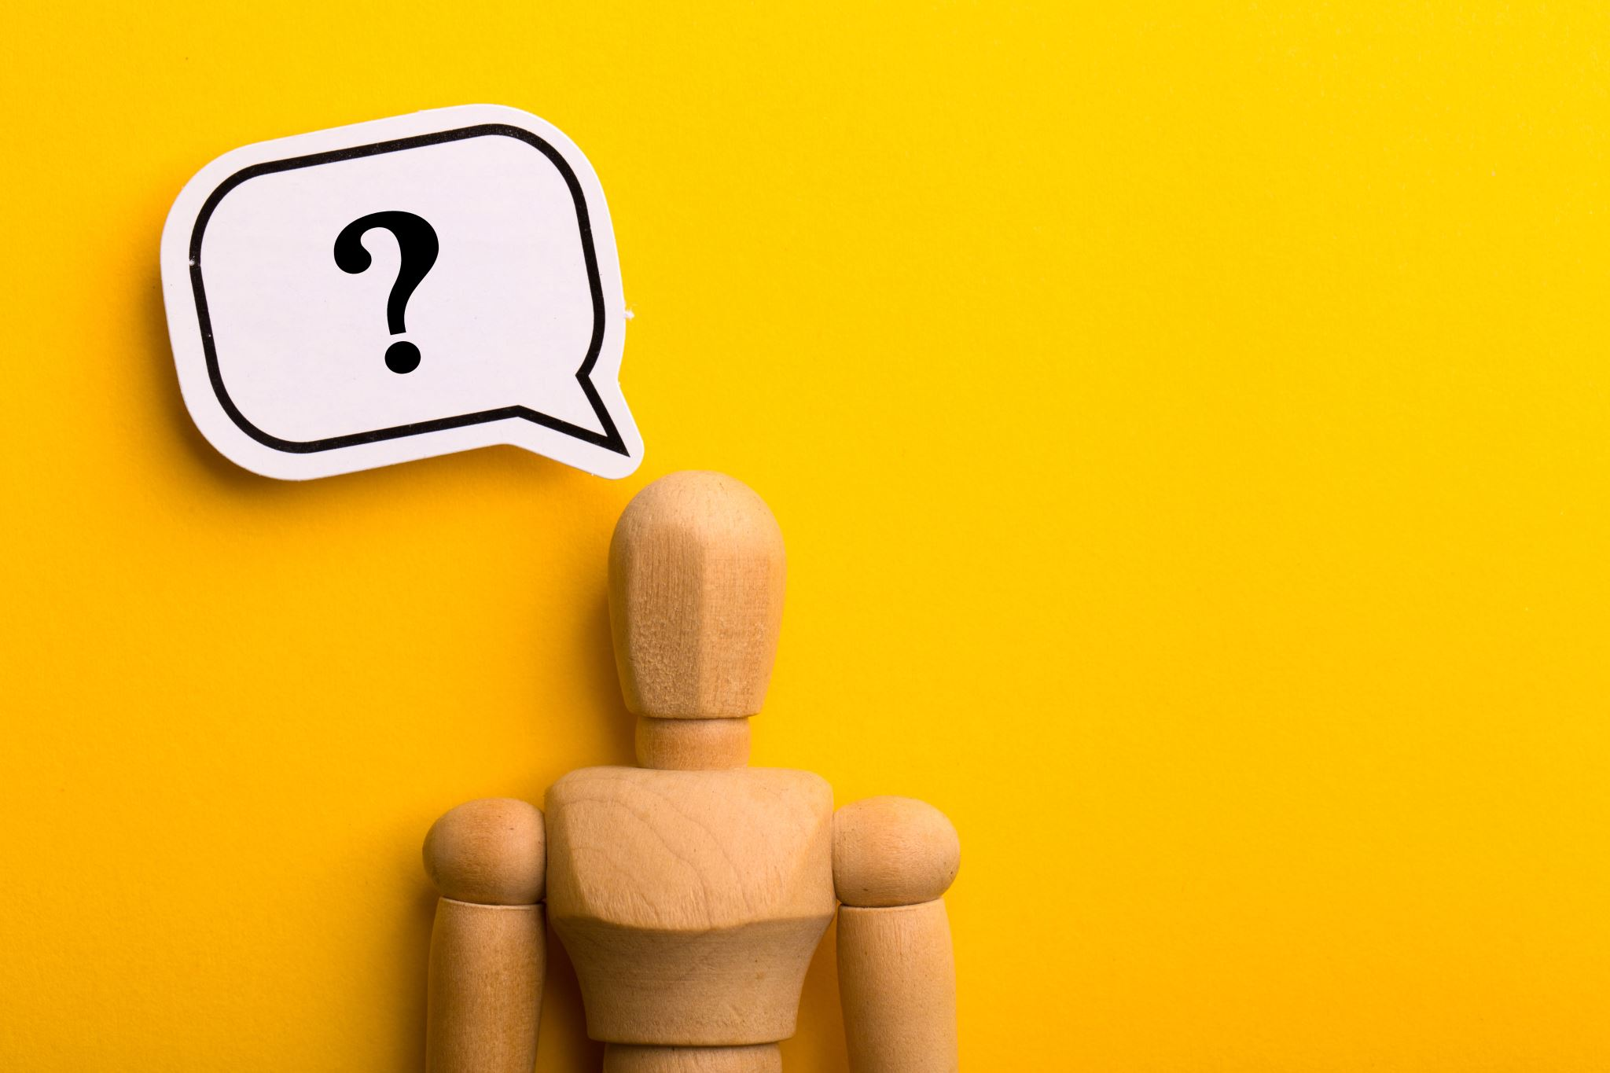
Sarcasm and Irony:
1. Example: "Oh, that's just what I needed - more work!”
- This statement sarcastically suggests that the speaker didn't need more work at all. NLP models need to recognize the tone to understand the true sentiment.
2. Example: "Oh, great! Another Monday morning.”
- This statement is often used sarcastically to express displeasure about the start of the workweek. NLP models need to recognize the tone and context to understand that the speaker is not genuinely enthusiastic

Slide 7
Language Variability:
Example: "Can I have a biscuit?" - In British English, "biscuit" refers to what Americans call a "cookie," while in American English, "biscuit" is a type of bread roll. Language variability between English dialects can lead to confusion.
2. Clothing Terminology:
In different English-speaking regions, the names for certain clothing items can vary significantly. For instance:
In the United States, a "sweater" is typically used to refer to a knitted garment designed to keep you warm in colder weather.
In the United Kingdom, that same item is often called a "jumper."
In Australia, it can be referred to as a "pullover" or a "jumper" as well.

Slide 8
Data Quality
Spelling and Typographical Errors:
Example: In a dataset of customer reviews, there are numerous misspelled words and typos. For instance, "restaurant" is spelled as "restaurnt," which can affect sentiment analysis results.
Data Imbalance:
Example: In a dataset used for text classification, there are significantly more samples of one class (e.g., "positive" sentiment) than another class (e.g., "negative" sentiment), leading to a biased model.

Slide 9

1. Bag Of Words
The "Bag of Words" (BoW) model is a simple and commonly used technique in natural language processing (NLP) for text analysis and feature extraction. It represents a text document as an unordered collection of words, discarding grammar, word order, and structure, and focusing solely on the presence or absence of words.

Slide 10
Steps in BoW
Tokenization
Vocabulary Creation
Vectorization

Slide 11
Tokenization
Consider the sentence: "The cat chased the mouse."
Tokenize the sentence into individual words:
Tokens:
"The"
"cat"
"chased"
"the"
"mouse"

Slide 12
Vocabulary Creation
Create a vocabulary by listing all unique words from the sentence:
Vocabulary:
"The"
"cat"
"chased"
"the"
"mouse"

Slide 13
Vectorization
Create a BoW vector based on word presence (1 if present, 0 if absent) in the vocabulary.
BoW Vector:
"The": 1
"cat": 1
"chased": 1
"the": 1
"mouse": 1
In this example, you can see that the word "the" appears twice in the sentence, but the BoW representation only accounts for its presence once. BoW focuses on whether a word is present or not, not on its frequency of occurrence.

Slide 14
Key points to note about the BoW model:
It simplifies text data by ignoring word order and structure.
It's a count-based representation, so word frequency information is retained.
It's often used as input for machine learning models like Naive Bayes, Decision Trees, or Support Vector Machines for text classification tasks.
BoW does not capture semantic meaning or word relationships, which can limit its effectiveness for certain NLP tasks.

Slide 15
2. Neural Network Models
Example: Text Classification Using a Neural Network
Suppose you have a dataset of movie reviews, and you want to classify each review as either "positive" or "negative" sentiment. You can use a neural network model for this task. Here's a simplified example:
Step 1: Data Preparation
Prepare your dataset, which consists of movie reviews and their corresponding sentiment labels.
Example Review 1: "I loved the movie. It was fantastic!" Sentiment Label 1: "Positive"
Example Review 2: "The film was terrible. I hated it." Sentiment Label 2: "Negative"

Slide 16
Step 2: Text Preprocessing
Tokenize the text: Split the reviews into words or tokens.
Create a vocabulary: Build a list of unique words from all the reviews.
Convert text to numerical format: Represent each review using numerical vectors, such as one-hot encoding. Here, we'll use one-hot encoding, where each word is represented as a binary vector.

Slide 17
Step 3: Neural Network Architecture
Design a neural network for text classification. A simple architecture consists of an input layer, one or more hidden layers, and an output layer with softmax activation to classify the sentiment as positive or negative.
Step 4: Training
Step 5: Prediction
Example Prediction:
Suppose you have a new movie review: "This film is amazing!"
Tokenize it: ["This", "film", "is", "amazing!"]
One-hot encode it based on the vocabulary:
"This": [1, 0, 0, 0, 0, 0, 0, 0, 0, 0, 0]
"film": [0, 0, 0, 0, 0, 0, 0, 1, 0, 0, 0]
"is": [0, 0, 0, 0, 0, 1, 0, 0, 0, 0, 0]
"amazing!": [0, 0, 0, 0, 0, 0, 0, 0, 0, 1, 0]
Feed the one-hot encoded vector into the trained neural network for prediction.
The network predicts a "Positive" sentiment for this review.

Slide 18
What is WordNet?
WordNet is like a digital dictionary with superpowers. It's not just a regular dictionary; it's a special tool that helps computers understand words in a more meaningful way. WordNet groups words with similar meanings together, shows how words are related to each other, and even helps figure out different meanings of the same word. It's like a superhero for computers when they're trying to understand and work with words in human language.

Slide 19
Example of WordNet
Word: "Car"
1: "Car" as an Automobile
Synonyms: automobile, motorcar, machine, motor vehicle
Hypernym (more general term): vehicle
Hyponyms (more specific terms): sedan, SUV, truck, convertible, etc.
Part Meronyms (parts of a car): wheel, engine, windshield, etc.

Slide 20
Problems with WordNet
Limited Language Coverage: WordNet provides extensive coverage for English words but may lack comprehensive support for other languages.
Word Sense Ambiguity:The word "bank" can mean a financial institution or the side of a river, depending on context.
Lack of Semantic Nuances: It may not distinguish between the subtle differences in synonyms like "happy" and "joyful."

Slide 21
Representing words as discrete symbols
Consider a vocabulary with five unique words: "apple”, "banana”, "cherry”, "date”, "grape”
- In this case, the vector dimension is 5 (one dimension for each word).
One-Hot Encoding:
"apple" = [1, 0, 0, 0, 0]
"banana" = [0, 1, 0, 0, 0]
"cherry" = [0, 0, 1, 0, 0]
"date" = [0, 0, 0, 1, 0]
"grape" = [0, 0, 0, 0, 1]

Slide 22
Problems with Discrete symbols
Problem: Lack of Similarity Information
Suppose we want to measure the similarity between two words, "cat" and "kitten," using one-hot encoding:
"cat" = [1, 0, 0, 0, 0]
"kitten" = [0, 1, 0, 0, 0]
In one-hot encoding, these two vectors are orthogonal (perpendicular) to each other.
There is no inherent notion of similarity or relatedness between the words in this representation.
Techniques like word embeddings (e.g., Word2Vec, GloVe) create dense vector representations that reflect semantic similarity between words.

Slide 23
Representing words by their context
Distributional semantics: A word’s meaning is given by the words that frequently appear close-by.
Representing words by their context is a fundamental concept in natural language processing (NLP) that aims to capture the meaning of words based on the words that surround them in text. One popular method for contextual word representation is word embeddings: Word2Vec

Slide 24
What is word vector?
A word vector, also known as a word embedding, is a numerical representation of a word in a continuous vector space.
"king" = [0.9, 0.8]
"queen" = [0.85, 0.9]
"man" = [0.2, 0.1]
"woman" = [0.15, 0.2]

Slide 25
Explanation
Now, we can observe some relationships between these word vectors:
Semantic Similarity: The vectors for "king" and "queen" are close to each other, reflecting their semantic similarity. Similarly, "man" and "woman" are close.
Analogies: Word vectors can be used to perform analogies. For example, to find the word related to "man" in the same way as "king" is related to "queen," you can calculate the vector:
king - queen + woman = ?

Slide 26
Word2Vec Example:
Imagine we have a small text corpus with the following sentence:
"Sara likes to play tennis."

Slide 27
Here's how Word2Vec works:
Vocabulary Creation: which includes unique words: ["Sara", "likes", "to", "play", "tennis"].
Context-Target Pairs (CBOW):
In the CBOW model, we predict a target word based on its surrounding context words.
For example, we can create a context-target pair like this:
Context: ["Sara", "to", "play"]
Target: "likes"
Model Training:
Word2Vec is trained using these context-target pairs. It learns to predict the target word "likes" based on the context words ["Sara", "to", "play"].
The model adjusts the word vectors during training to minimize prediction errors.

Slide 28
4. Word Vectors:
After training, Word2Vec produces word vectors (embeddings) for each word in the vocabulary.
These vectors capture semantic relationships based on the context in which words appear.
For example:
"Sara" = [0.2, 0.5, ...]
"likes" = [0.7, 0.3, ...]
"tennis" = [0.9, 0.6, ...]
5. Semantic Relationships:
The vectors capture semantic relationships. For example, vectors for similar words will be close in the vector space.

Slide 29
2 model variant
Continuous Bag of Words (CBOW) Model:
In CBOW, the model predicts a target word based on its context (surrounding words).
Example: Given the context ["Sara", "to", "play"], predict the target word "likes."
Skip-Gram Model:
In the Skip-Gram model, the goal is to predict context words given a target word.
Example: Given the target word "likes," predict the context words ["Sara", "to", "play"].

Slide 30

Thank you.

